Slide 1
How well-aligned are critics’ scores really?
Christy Hui
Stats 404
June 5th, 2025

Slide 2
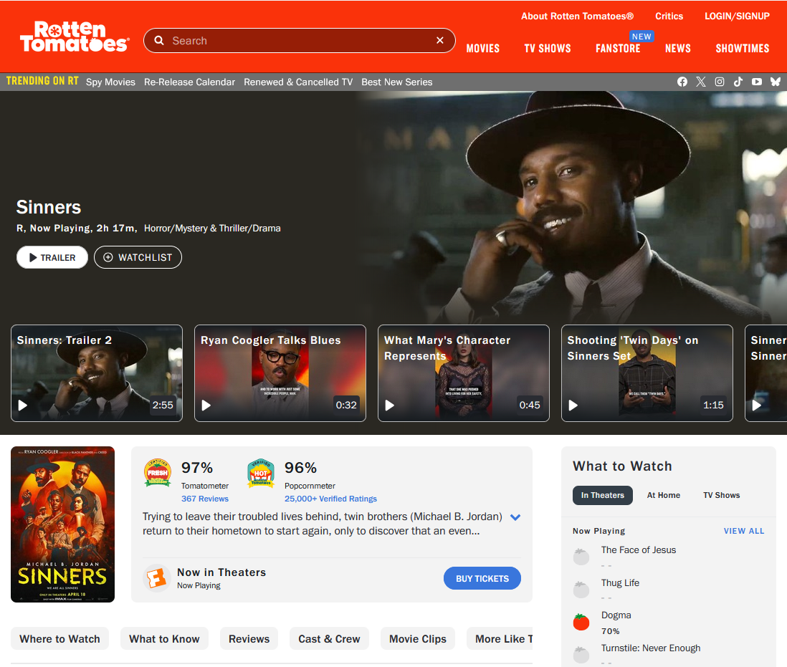
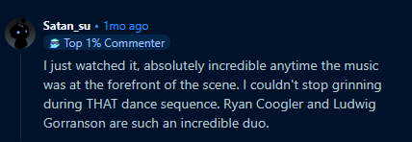
01
Get some movie recommendation
02
Ask around
03
Look at critics ratings
04
Search for users ratings
05
Watch the movie
06
Give your own input

Slide 3

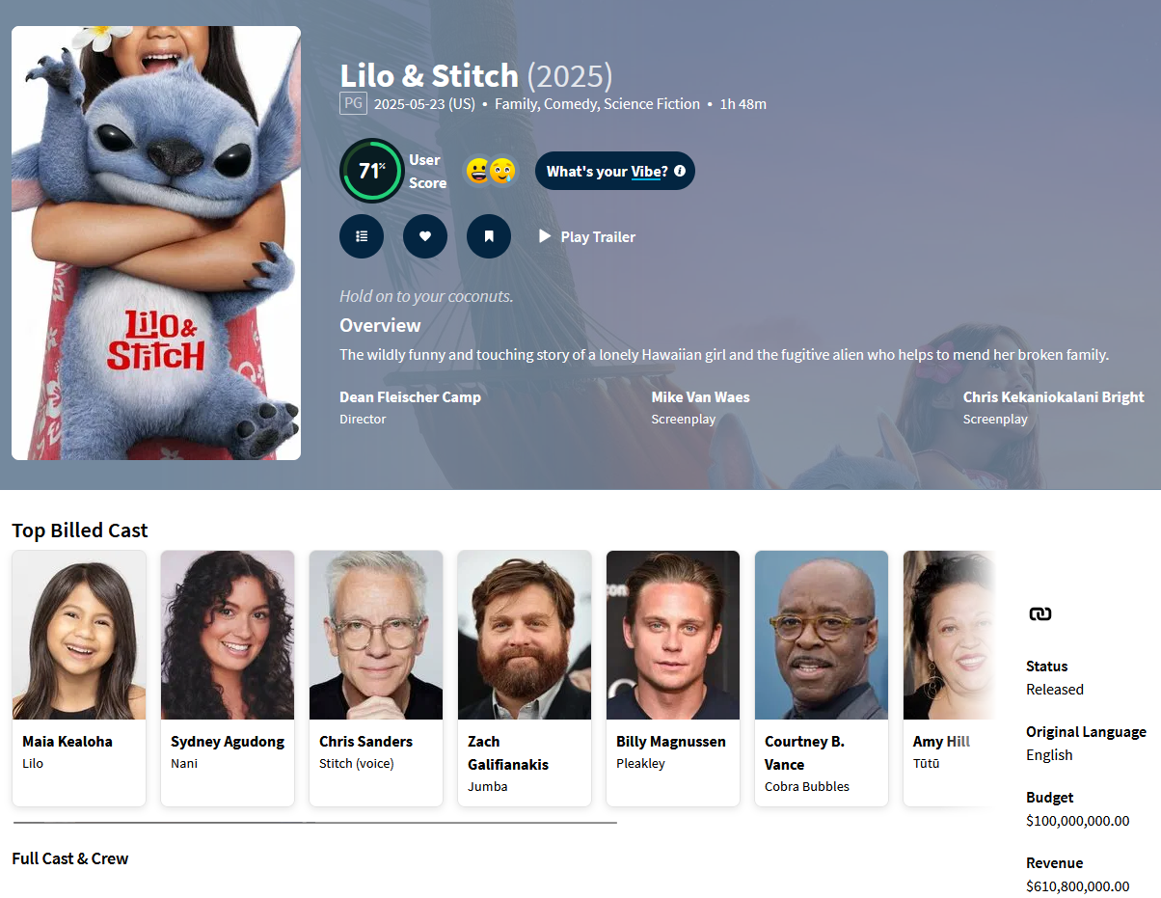
The Movie Database (TMDB)
Categorical/List Objects
Numerical Objects
Misc.
Title, Original Language, Genres, Original Country
Popularity, Vote Average, VoteCount, Budget, Revenue, Runtime, NumSpokenLanguages
Release Date (Datetime), BelongsToCollection (Boolean)

Slide 4

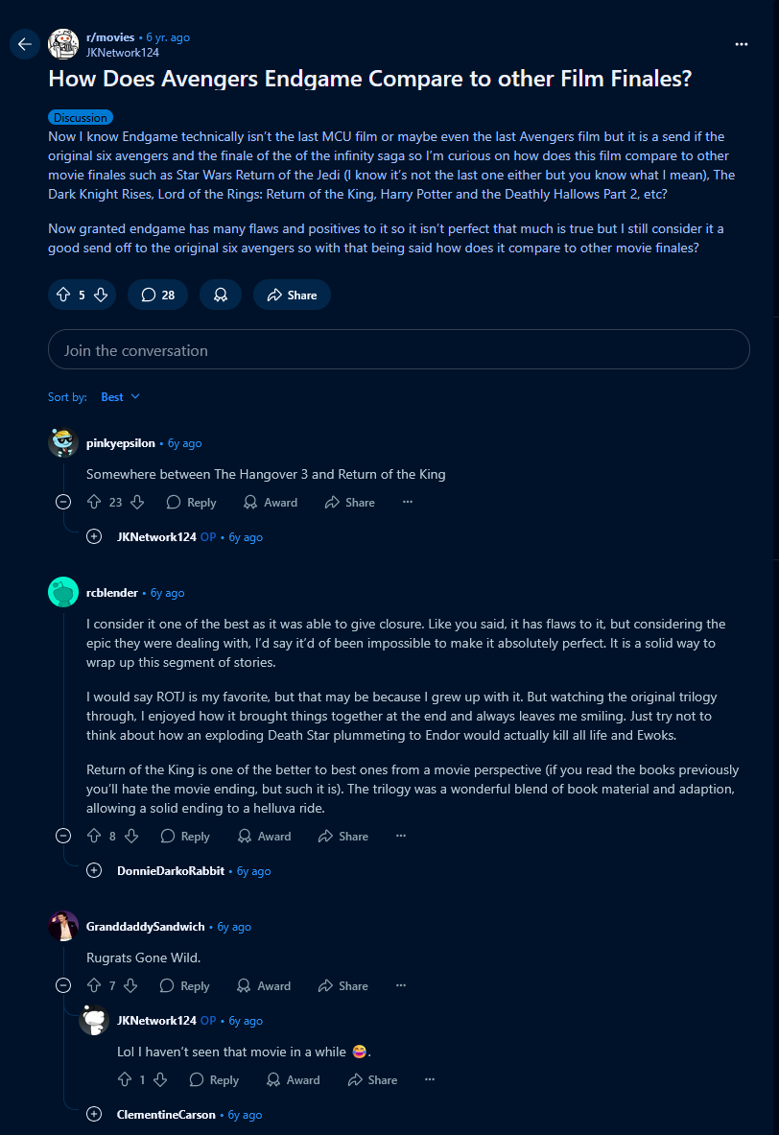
Reddit Sentiment Score (Weighted)
Calculate Sentiment Score (VADER) of post and comments, weighing each by upvotes
Compute average sentiment from posts and comments
Repeat process

Slide 5

Rotten Tomatoes Score
Number of Positive (Fresh) Reviews
÷
Total Number of Reviews
=
Rotten Tomatoes Score (Tomatometer)

Slide 6
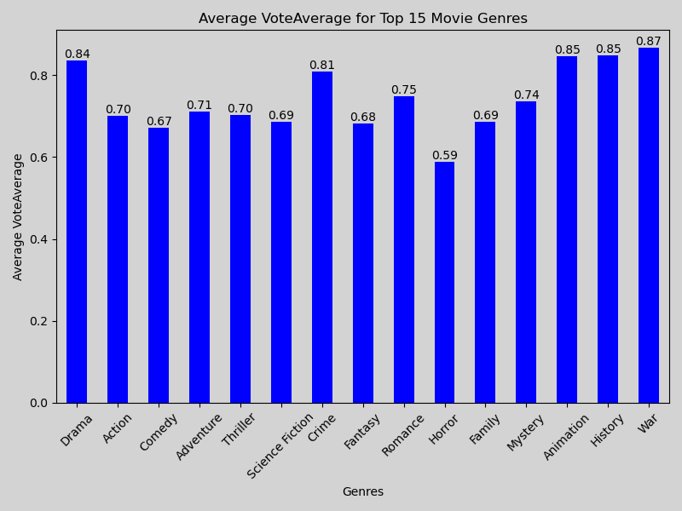
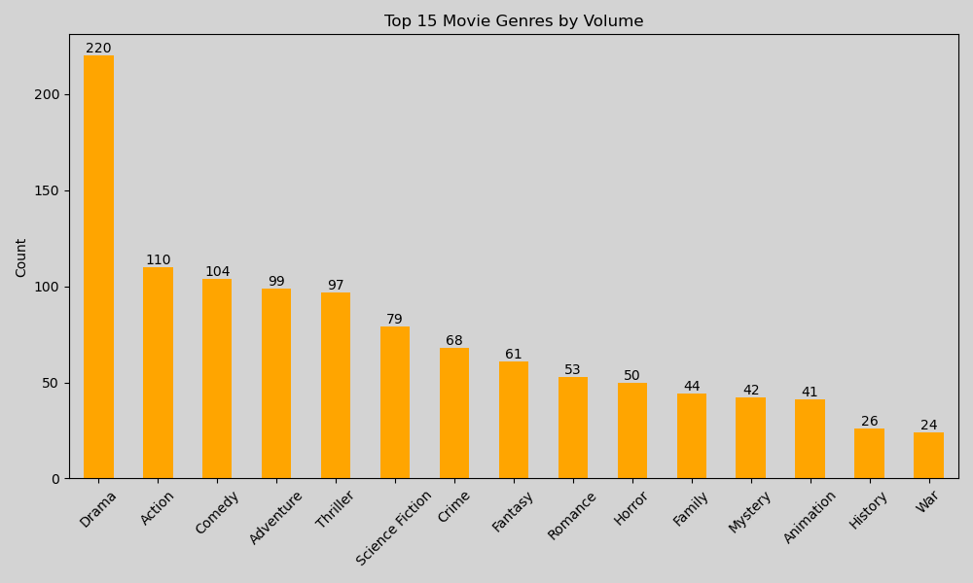
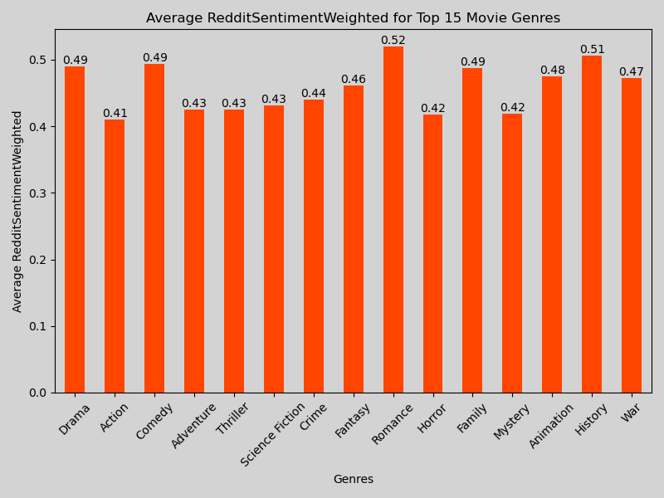
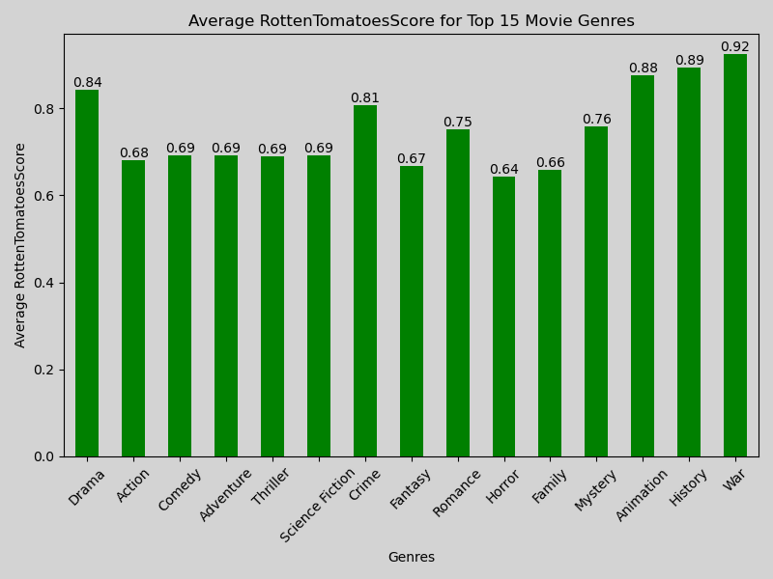
Genres

Slide 7
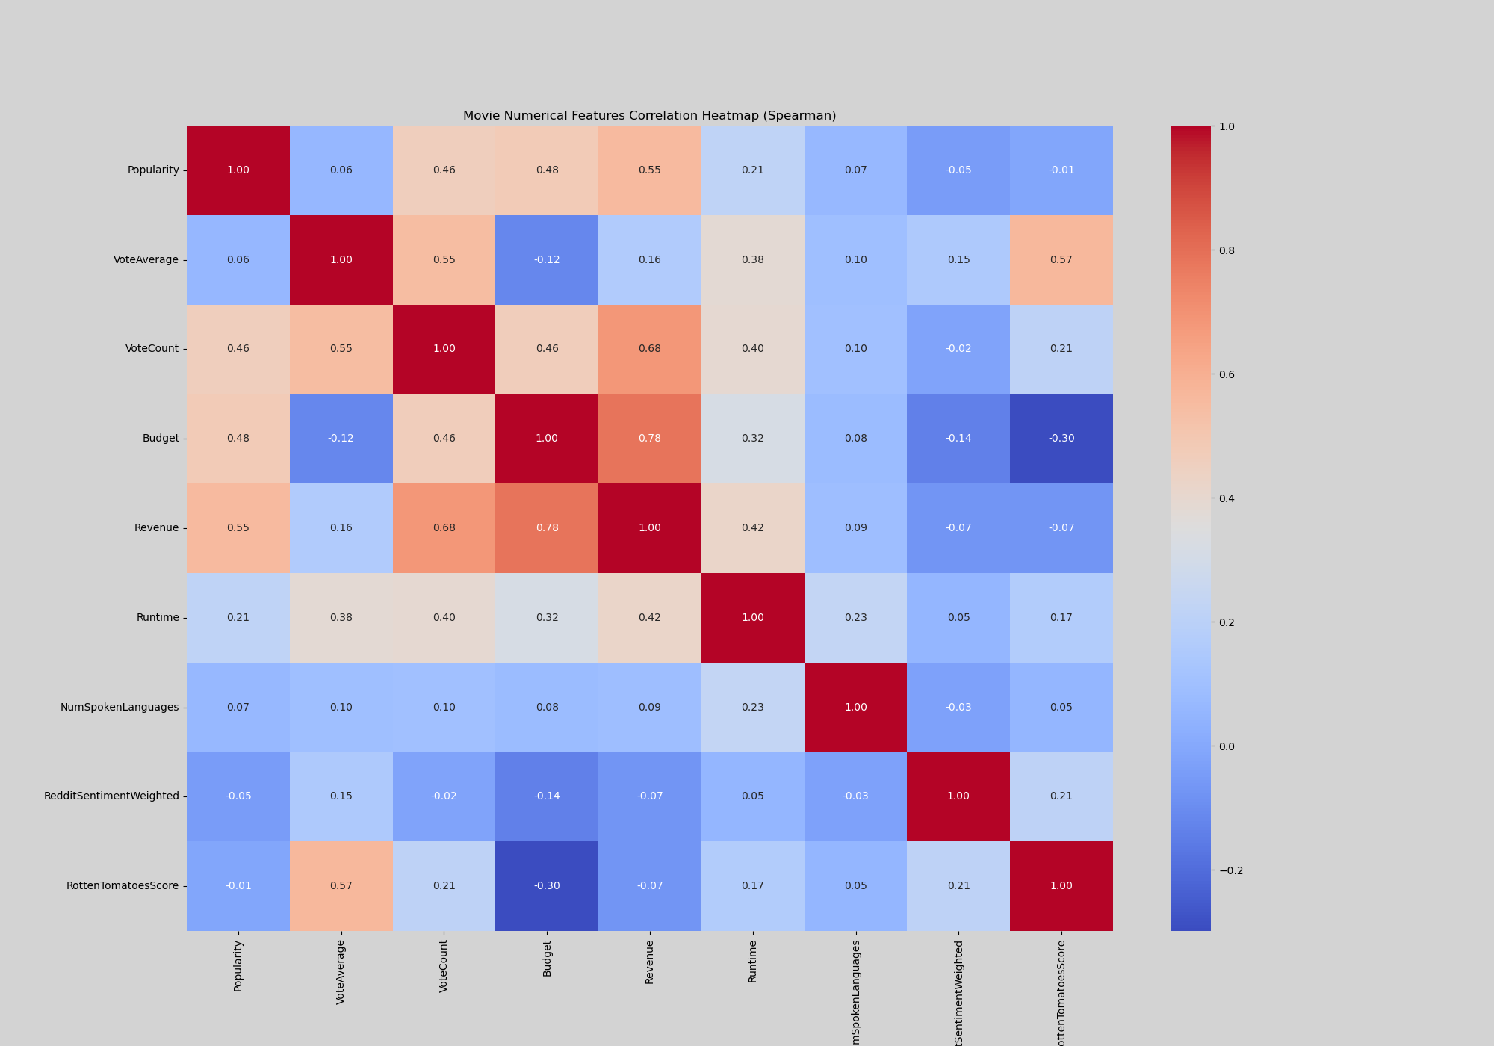
Pearson
Spearman
Rotten Tomatoes vs:
Popularity: -0.01
VoteAverage: 0.80
VoteCount: 0.27
Budget: -0.04
Revenue: 0.12
Runtime: 0.30
NumSpokenLanguages: 0.09
RedditSentimentWeighted: 0.17

Slide 8
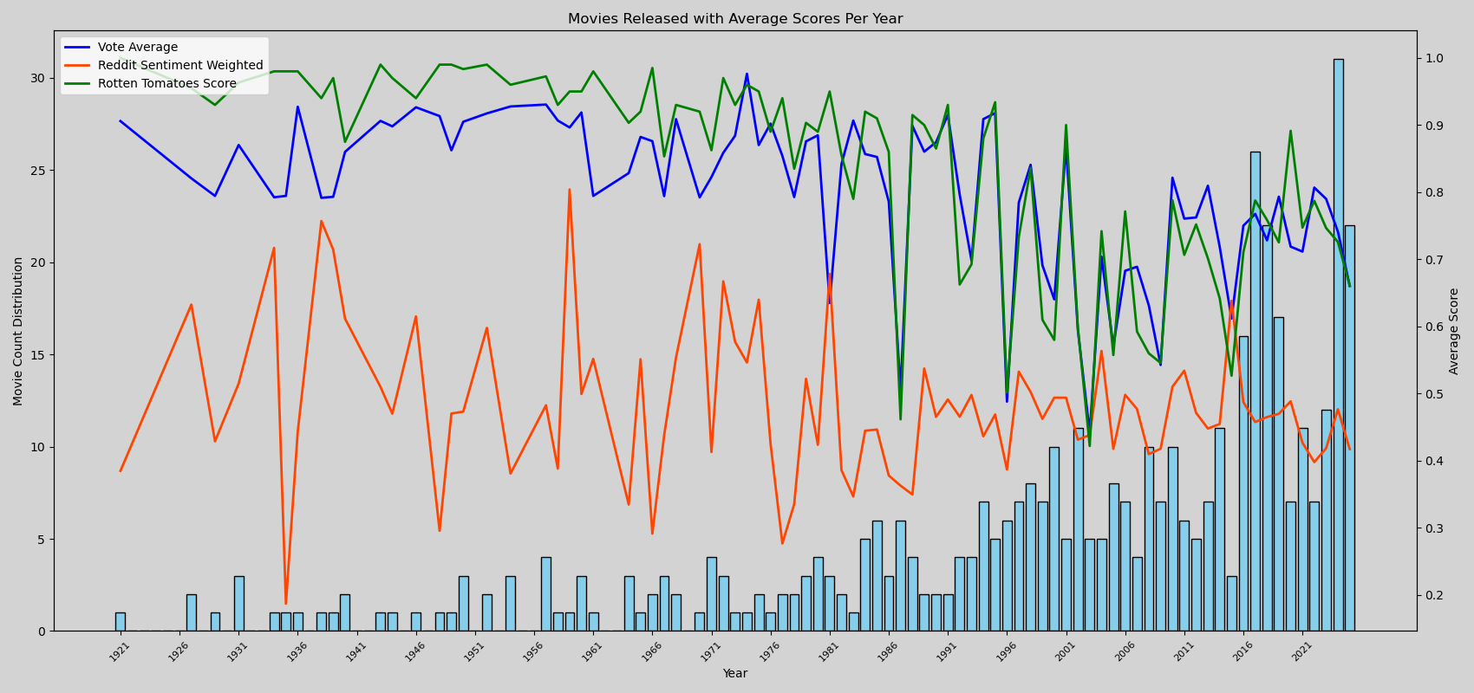
Movies Released Per Year

Slide 9
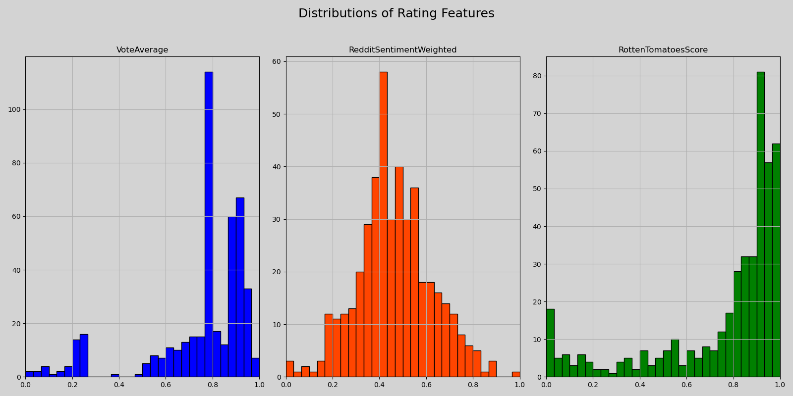
Ratings - Distributions and Mean
Vote Average Mean:
0.75
Reddit Sentiment Mean:
0.46
Rotten Tomatoes Mean:
0.76

Slide 10
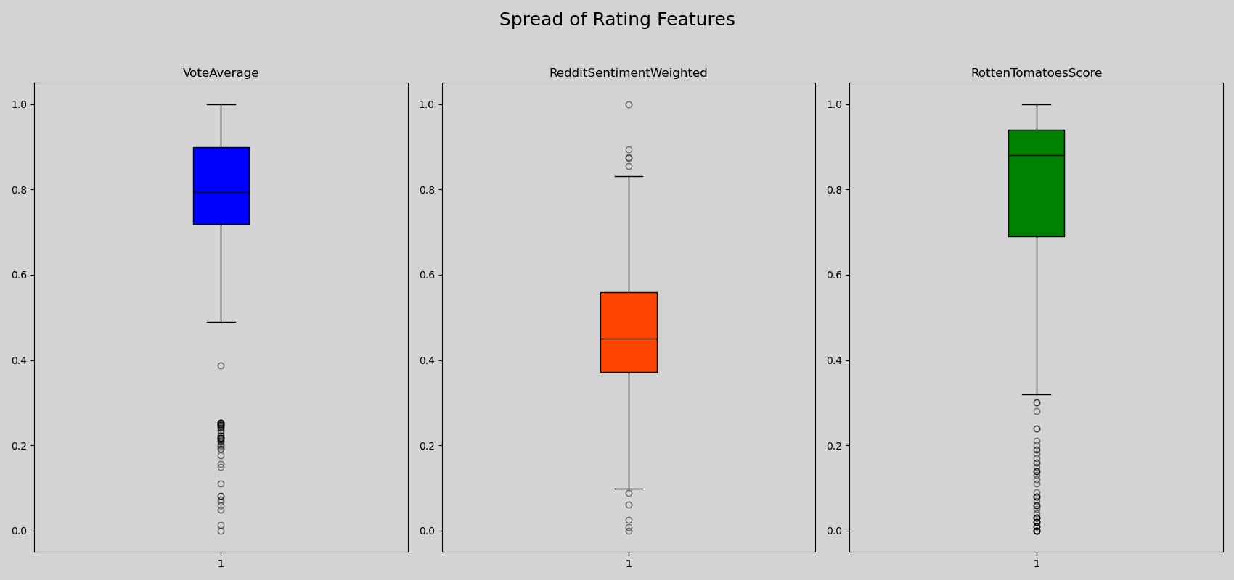
Ratings - Spread and Median
Vote Average Median:
0.79
Reddit Sentiment Median:
0.45
Rotten Tomatoes Median:
0.88

Slide 11
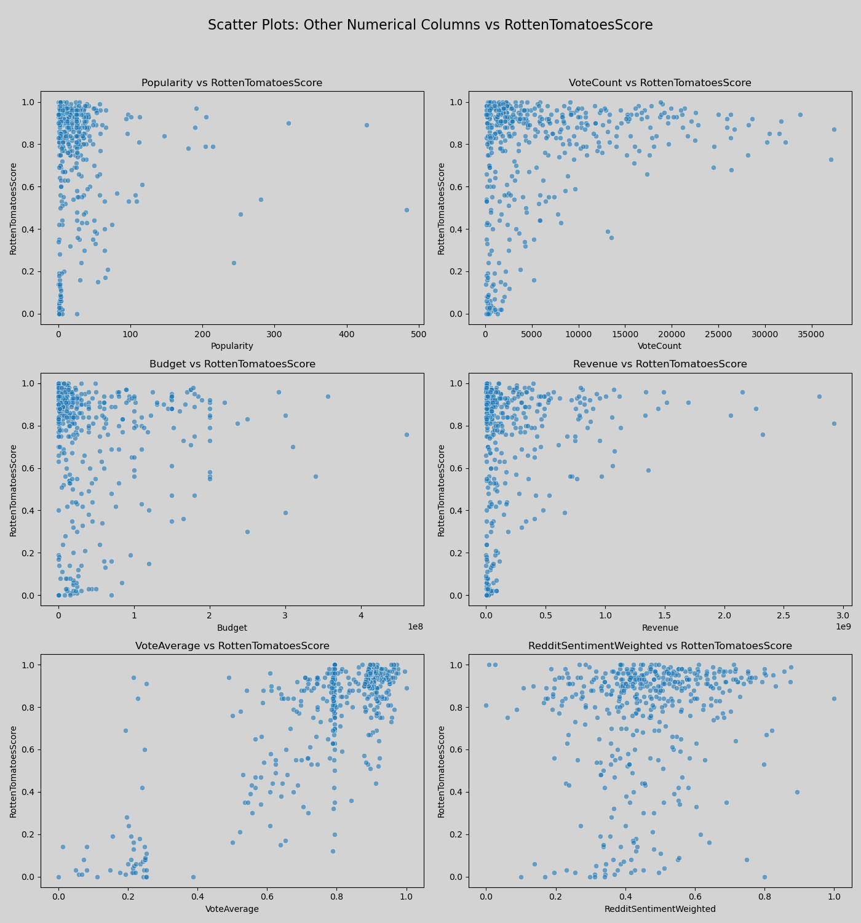
Scatter Plots
Other Numerical Columns
Vs
Rotten Tomatoes Scores

Slide 12
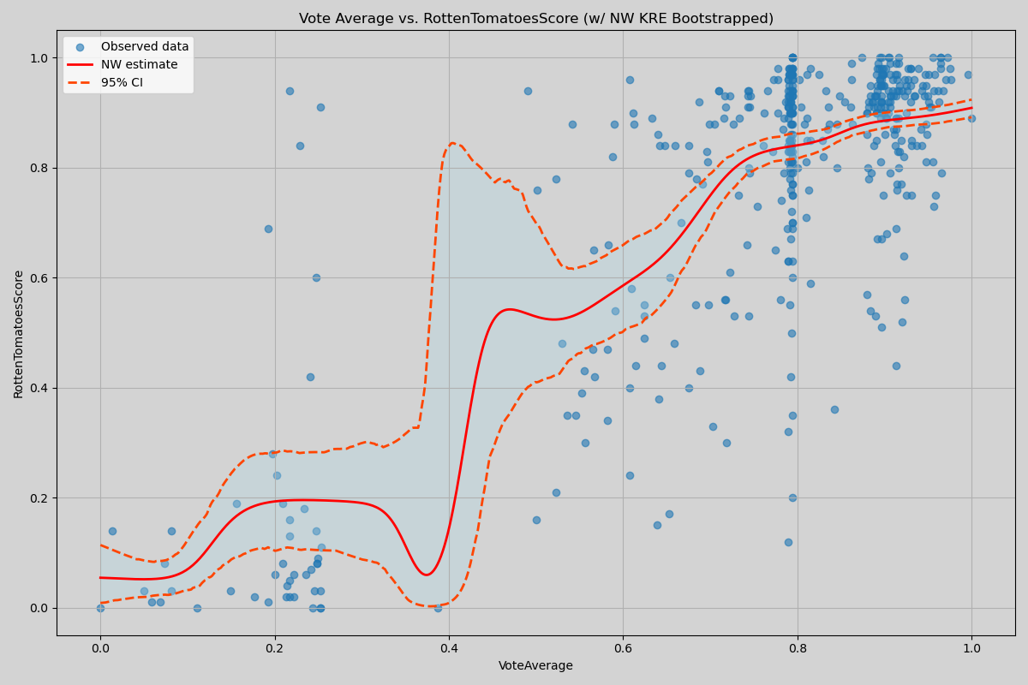
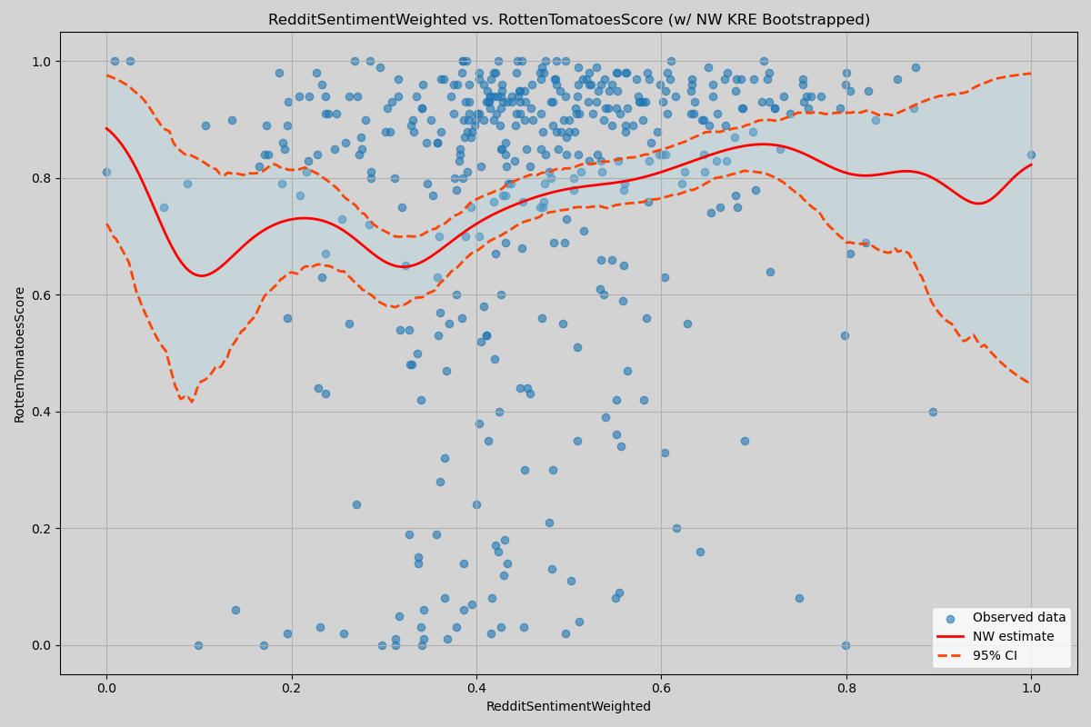
Ratings Scatterplots (Nadaraya-Watson KRE)
Vote Average vs RTS
Reddit Sentiment vs RTS

Slide 13
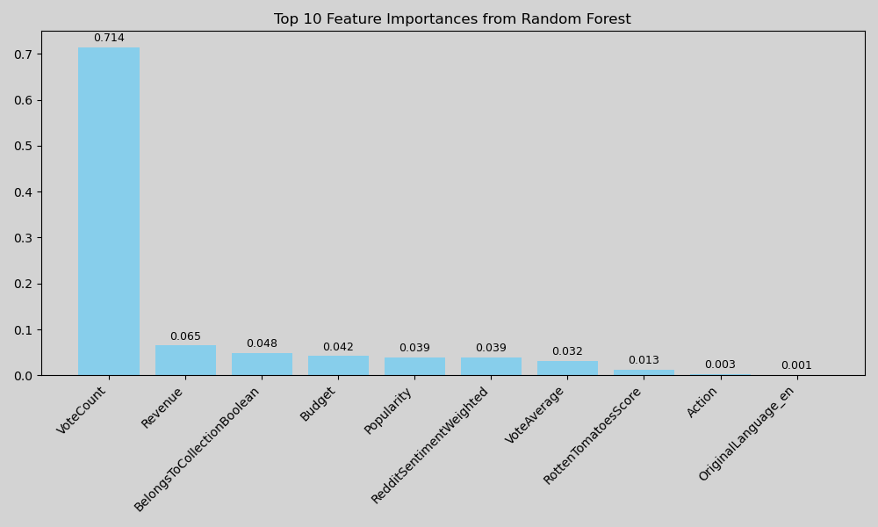
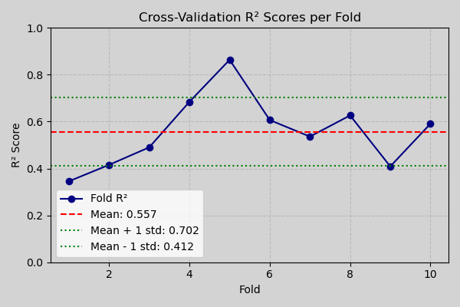
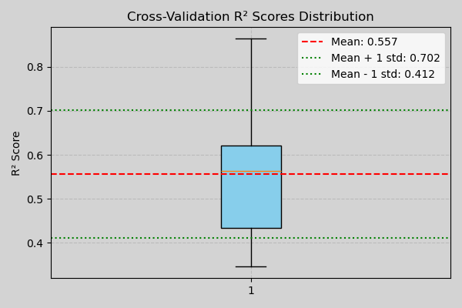
Random Forest Results

Slide 14
Limitations
Data
Time
Money
Data is skewed more toward higher-voted movies. People tend to comment or vote on movies they like; as such, there is an inherent bias for better movies.
Data was scraped mid-May 2025 and is very time dependent. Popular movies now will change in a year’s time.
Higher API rate limits can be requested with more money. However, for the sake of this project, default API limits were used.

Slide 15
Thank you!

